Slide 1

Raspberry pi GPIO Basic’s (GUI)
Lecturer: Reza Arjmandi
Summer 2016
Preface:
This chapter contains some basic recipes for setting up and using the Raspberry Pi’s general-purpose input/output (GPIO) connector.

Slide 2
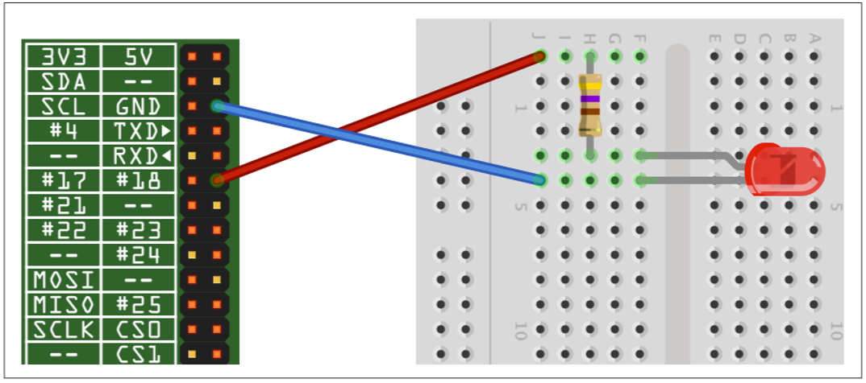
Connecting an LED
Connect an LED to one of the GPIO pins using a 470Ω or 1kΩ series resistor to limit the current.

Slide 3
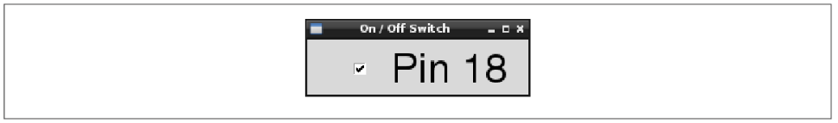
Making a User Interface to Turn Things On and Off
You want to make an application to run on the Raspberry Pi that has a button for turning things on and off.
Using the Tkinter library user interface framework, write a Python program that uses a checkbutton to turn the GPIO pin on and off (following figure)

Slide 4
Gui_Switch.py Project
from Tkinter import *
import RPi.GPIO as GPIO
import time
GPIO.setmode(GPIO.BCM)
GPIO.setup(18, GPIO.OUT)
class App:
def __init__(self, master):
frame = Frame(master)
frame.pack()
self.check_var = BooleanVar()
check = Checkbutton(frame, text='Pin 18', command=self.update,variable=self.check_var, onvalue=True, offvalue=False)
check.grid(row=1)
def update(self):
GPIO.output(18, self.check_var.get())
root = Tk()
root.wm_title('On / Off Switch')
app = App(root)
root.geometry("200x50+0+0")
root.mainloop()

Slide 5
Making a User Interface to Turn Things On and Off
In Python 3, the Tkinter library has been renamed tkinter with a lowercase t.
Note that you will need to run it with sudo because the RPi.GPIO requires you to have superuser privileges to access the GPIO hardware
The example program defines a class called App that contains most of the application code. Its initializer function creates a member variable called check_var that contains an instance of BooleanVar that is then supplied as the variable option to the checkbutton. This ensures that every time the checkbutton is clicked, the value in this variable will be changed. The command option runs the update command every time such a change occurs.
The update function simply writes the value in check_var to the GPIO output.

Slide 6
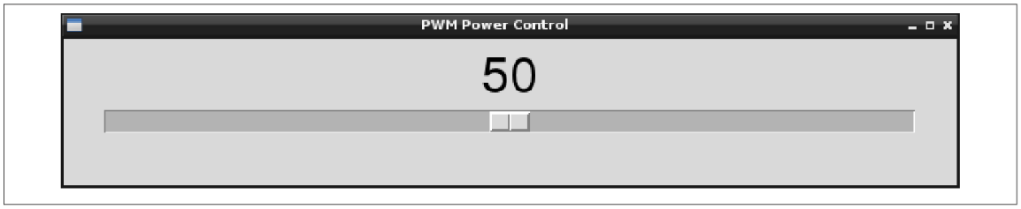
Making a User Interface to Control PWM Power for LEDs and Motors
You want to make an application to run on the Raspberry Pi that has a slider to control power to a device using PWM.
Using the Tkinter user interface framework, write a Python program that uses a slider to change the PWM duty cycle between 0 and 100 percent (following figure)

Slide 7
Gui_Slider.py Project
from Tkinter import *
import RPi.GPIO as GPIO
import time
GPIO.setmode(GPIO.BCM)
GPIO.setup(18, GPIO.OUT)
pwm = GPIO.PWM(18, 500)
pwm.start(100)
class App:
def __init__(self, master):
frame = Frame(master)
frame.pack()
scale = Scale(frame, from_=0, to=100,orient=HORIZONTAL, command=self.update)
scale.grid(row=0)
def update(self, duty):
pwm.ChangeDutyCycle(float(duty))
root = Tk()
root.wm_title('PWM Power Control')
app = App(root)
root.geometry("200x50+0+0")
root.mainloop()

Slide 8
Making a User Interface to Control PWM Power for LEDs and Motors
Note that you will need to run it with sudo because the RPi.GPIO requires you to have superuser privileges to access the GPIO hardware.
In Python 3, the Tkinter library has been renamed tkinter, with a lowercase t.
The example program defines a class called App that contains most of the application code. The command option runs the update command every time the value of the slider is changed. This updates the duty cycle of the output pin.

Slide 9
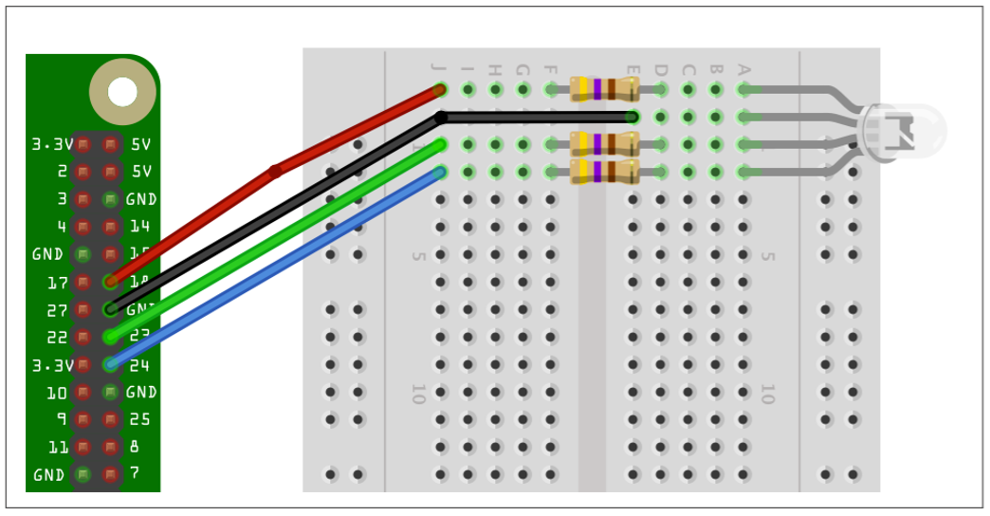
Changing the Color of an RGB LED
Use PWM to control the power to each of the red, green, and blue channels of an RGB LED.

Slide 10
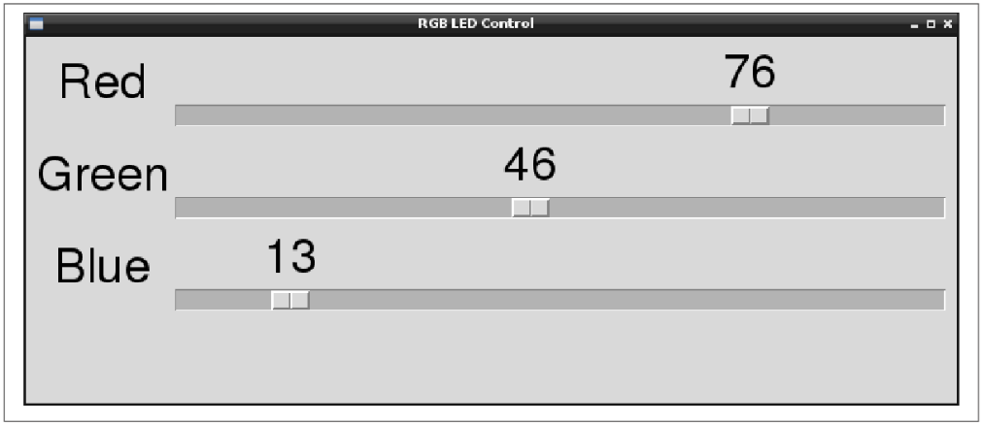
Changing the Color of an RGB LED
A typical project using a Raspberry Pi requires 5V at up to about 600mA . The requirement for 5V is strict. You should not try to power your Pi from more or less than 5V.
The type of RGB LED used here is a common cathode. If you have the common anode type, then you can still use it, but connect the common anode to the 3.3V pin on the GPIO connector. You will then find that the slider becomes reversed, so a setting of 100 becomes off and 0 becomes full on.
When you are selecting an LED for this project, LEDs labeled diffused are best because it allows the colors to be mixed better.

Slide 11
Gui_Slider_RGB_LED.py Project
from Tkinter import *
import RPi.GPIO as GPIO
import time
GPIO.setmode(GPIO.BCM)
GPIO.setup(18, GPIO.OUT)
GPIO.setup(23, GPIO.OUT)
GPIO.setup(24, GPIO.OUT)
pwmRed = GPIO.PWM(18, 500)
pwmRed.start(100)
pwmGreen = GPIO.PWM(23, 500)
pwmGreen.start(100)
pwmBlue = GPIO.PWM(24, 500)
pwmBlue.start(100)
class App:
def __init__(self, master):
frame = Frame(master)
frame.pack()
Label(frame, text='Red').grid(row=0, column=0)
Label(frame, text='Green').grid(row=1, column=0)
Label(frame, text='Blue').grid(row=2, column=0)
scaleRed = Scale(frame, from_=0, to=100, orient=HORIZONTAL, command=self.updateRed) scaleRed.grid(row=0, column=1)
scaleGreen = Scale(frame, from_=0, to=100,orient=HORIZONTAL,command=self.updateGreen)

Slide 12
Gui_Slider_RGB_LED.py Project
scaleGreen.grid(row=1, column=1)
scaleBlue = Scale(frame, from_=0, to=100, orient=HORIZONTAL, command=self.updateBlue) scaleBlue.grid(row=2, column=1)
def updateRed(self, duty):
pwmRed.ChangeDutyCycle(float(duty))
def updateGreen(self, duty):
pwmGreen.ChangeDutyCycle(float(duty))
def updateBlue(self, duty):
pwmBlue.ChangeDutyCycle(float(duty))
root = Tk()
root.wm_title('RGB LED Control')
app = App(root)
root.geometry("200x150+0+0")
root.mainloop()

Slide 13
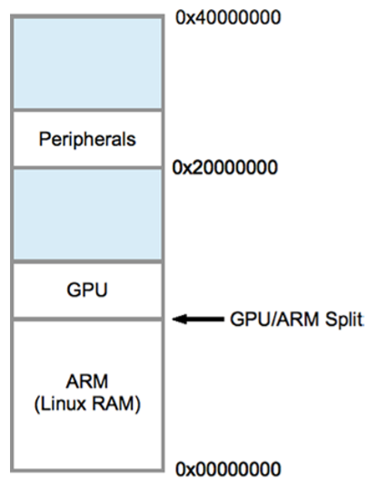
Direct Register Access
Let’s now turn our attention to the Raspberry Pi’s physical memory layout. Normally, physical memory isn’t a concern to application programmers, because the operating system and its drivers provide an abstract and often portable way to access them. However, when this support is absent, direct access to a peripheral like the PWM controller is necessary. Following Figure illustrates the physical addressing used on the Raspberry Pi. The SDRAM starts at physical address zero and works up to the ARM/GPU split point . The ARM peripherals are mapped to physical memory starting at the address of 0x20000000. This starting address is of keen interest to Pi programmers.

Slide 14
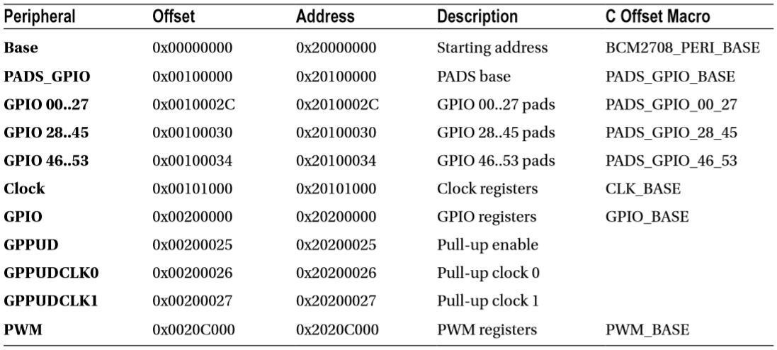
Direct Register Access
In the region labeled Peripherals, the offsets and addresses indicated in following Table are of interest to us.

Slide 15
Memory Mapping
To gain access to physical memory under Linux, we make use of the /dev/mem character device and the mmap(2) system call.
The mmap(2) system call API is shown here:
#include <sys/mman.h>
void ∗ mmap(
void ∗addr, /∗Address to use ∗/
size_t length, /∗Number of bytes to access ∗/
int prot, /∗Memory protection ∗/
int flags, /∗Option flags ∗/
int fd, /∗Opened file descriptor ∗/
off_t offset /∗Starting off set ∗/
) ;

Slide 16
Memory Mapping
Rather than look at all the options and flags available to this somewhat complicated system call, let’s look at the ones that we use in the following code:
#include <sys/mman.h>
static char ∗map = 0;
static void gpio_init()
{
int fd;
char ∗map;
fd = open("/dev/mem",O_RDWR|O_SYNC) ; /∗Needs root access ∗/
if ( fd < 0 ) {
perror("Opening /dev/mem") ;
exit(1) ;
}
map = (char ∗) mmap(
NULL, /∗Any address ∗/
BLOCK_SIZE, /∗ # of bytes ∗/
PROT_READ|PROT_WRITE,
MAP_SHARED, /∗Shared ∗/
fd, /∗ /dev/mem ∗/
GPIO_BASE /∗Offset to GPIO ∗/ ) ;
if ( (long)map == −1L ) {
perror("mmap(/dev/mem)");
exit(1) ; }
close(fd);
ugpio = (volatile unsigned ∗)map;
}

Slide 17
Memory Mapping
The first thing performed in this code is to open the device driver node /dev/mem. It is opened for reading and writing (O_RDWR), and the option flag O_SYNC requests that any write(2) call to this file descriptor result in blocking the execution of the caller until it has completed.
Next, the mmap(2) call is invoked. The address argument is provided with NULL (zero) so that the kernel can choose where to map it into the caller’s address space. If the application were to specify a starting address to use and the kernel was not able use it, the system call would fail. The starting address is returned and assigned to the character pointer map in the preceding listing.
Argument 2 is supplied with the macro BLOCK_SIZE in this example. This is the number of bytes you would like to map into your address space. This was defined earlier in the program as 4 KB:
#define BLOCK_SIZE (4∗1024)
The third mmap(2) argument is supplied with the flags PROT_READ and PROT_WRITE. This indicates that the application wants both read and write access to the memory-mapped region.

Slide 18
Memory Mapping
The flags argument is supplied with the value MAP_SHARED. This permits nonexclusive access to the underlying mapping.
This argument supplies the underlying opened file to be mapped into memory. In this case, we map a region of physical ARM memory into our application by using the opened device driver node /dev/mem.
This last argument specifies the location in physical memory where we want to start our access. For the GPIO registers, it is the address 0x20200000.

Slide 19
Memory Mapping
The return value, when successful, will be an application address that points to the physical memory region we asked for. The application programmer need not be concerned with what this address is, except to save and use it for access.
The return value is also used for indicating failure, so this should be checked and handled:
if ( (long) map == –1L ) {
perror("mmap(/dev/mem)");
exit(1);
}
The returned address (pointer) map is cast to a long integer and compared to -1L. This is the magic value that indicates that an error occurred. The error code is found in errno.

Slide 20
Memory Mapping
The last section of this initialization code for GPIO assigns the address map to another variable, ugpio, as follows:
ugpio = (volatile unsigned ∗)map;
The value ugpio was defined earlier in the program:
static volatile unsigned ∗ugpio = 0;
There are two things noteworthy about this:
The data type is an unsigned int (32 bits on the Pi).
The pointed-to data is marked as volatile.
Since the Pis registers are 32 bits in size, it is often more convenient to access them as 32-bit words. The unsigned data type is perfect for this. But be careful with offsets in conjunction with this pointer, since they will be word offsets rather than byte offsets.

Slide 21
Memory Mapping
The volatile keyword tells the compiler not to optimize access to memory through the pointer variable. Imagine code that reads a peripheral register and reads the same register again later, to see whether an event has occurred.
An optimizing compiler might say to itself, “I already have this value in CPU register R, so I’ll just use that since it is faster.” But the effect of this code is that it will never see a bit change in the peripheral’s register because that data was not fetched back into a CPU register.
The volatile keyword forces the compiler to retrieve the value even though it would be faster to use the value still found in a register.

Slide 22
Memory Mapping
In the previous section, you looked at how to access physical memory in an application, provided that you had the rights to do so (root or setuid).
The Broadcom Corporation PDF manual “BCM2835 ARM Peripherals,” page 5, also shows a virtual memory layout on the right.
This should not be confused with the physical memory layout that you examined earlier. Virtual memory can be accessed through /dev/kmem driver node using mmap(2), but we won’t be needing that in this chapter.

Slide 23
GPIO Configuration
Each GPIO pin is affected by several configuration choices:
General-purpose input, output, or alternate function
Input event detection method
Input pull-up/pull-down resistors
Output drive level

Slide 24
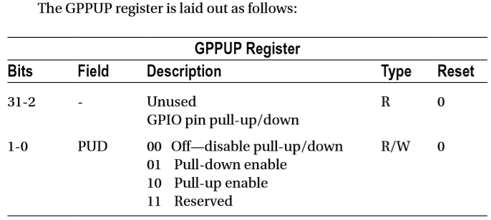
Pull-up Resistors
As noted earlier, GPIO pins 2 and 3 have an external resistor tied to the +3.3 V rail. The remaining GPIO pins are pulled high or low by an internal 50 kΩ resistor in the SoC.
The pull-up configuration of a GPIO pin can be configured using the SoC registers GPPUP and GPPUDCLK0/1.

Slide 25
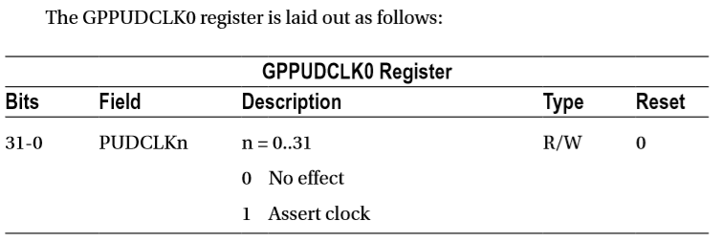
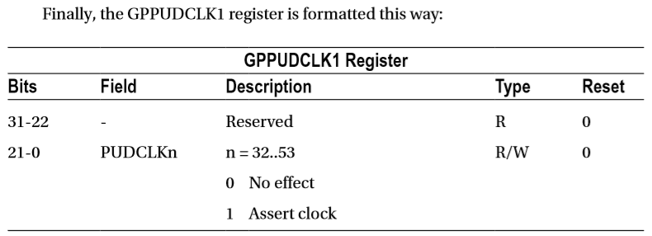
Pull-up Resistors

Slide 26
Pull-up Resistors
According to the Broadcom documentation, the general procedure for programming the pull-up resistor is this:
1. Write the pull-up configuration desired in the rightmost 2 bits of the 32-bit GPPUP register. The configuration choices are as follows:
00: Disable pull-up control.
01: Enable pull-down control.
10: Enable pull-up control.
2. Wait 150 cycles to allow the preceding write to be registered.
3. Write a 1-bit to every GPIO position, in the group of 32 GPIO pins being configured. GPIOs 0–31 are configured by register GPPUDCLK0.
4. Wait another 150 cycles to allow step 3 to register.
5. Write 00 to GPPUP to remove the control signal.
6. Wait another 150 cycles to allow step 5 to register.
7. Finally, write to GPPUDCLK0/1 to remove the clock.

Slide 27
Pull-up Resistors
The Broadcom procedure may seem confusing because of the word clock. Writing to GPPUP and GPPUDCLK0/1 registers by using the preceding procedure is designed to provide a pulse to the internal pull-up resistor flip-flops (their data clock input).
First a state is established in step 1, and then the configured 1 bits are clocked high in step 3 (for selected GPIO pins). Step 5 establishes a zero state, which is then sent to the flip-flop clock inputs in step 7.
The documentation also states that the current settings for the pull-up drivers cannot be read. This makes sense when you consider that the state is held by these internal flip-flops that were changed by the procedure. (There is no register access available to read these flip-flops.)
Fortunately, when configuring the state of a particular GPIO pin, you change only the pins you select by the GPPUDCLK0/1 register. The others remain unchanged.
The program pullup.c, shown next, provides a simple utility to change the pull-up resistor settings.
$ ./pullup 7=low 8=high

Slide 28
Pull-up Resistors
1 /∗∗∗∗∗∗∗∗∗∗∗∗∗∗∗∗∗∗∗∗∗∗∗∗∗∗∗∗∗∗∗∗∗∗∗∗∗∗∗∗∗∗∗∗∗∗∗∗∗∗∗∗∗∗∗∗∗∗∗∗∗∗∗∗∗∗∗∗∗
2 ∗ pullup.c : Change the pull−up resistor setting for GPIO pin
3 ∗∗∗∗∗∗∗∗∗∗∗∗∗∗∗∗∗∗∗∗∗∗∗∗∗∗∗∗∗∗∗∗∗∗∗∗∗∗∗∗∗∗∗∗∗∗∗∗∗∗∗∗∗∗∗∗∗∗∗∗∗∗∗∗∗∗∗∗∗/
4
5 #include <stdio.h>
6 #include <stdlib.h>
7 #include <fcntl.h>
8 #include <unistd.h>
9 #include <errno.h>
10 #include <setjmp.h>
11 #include <sys/mman.h>
12 #include <signal.h>
13
14 #include "gpio_io.c" /∗GPIO routines ∗/
15 #include "timed_wait.c" /∗Delay ∗/
16

Slide 29
Pull-up Resistors
17 /∗∗∗∗∗∗∗∗∗∗∗∗∗∗∗∗∗∗∗∗∗∗∗∗∗∗∗∗∗∗∗∗∗∗∗∗∗∗∗∗∗∗∗∗∗∗∗∗∗∗∗∗∗∗∗∗∗∗∗∗∗∗∗∗∗∗∗∗∗
18 ∗ 0x7E200094 GPPUD GPIO Pin Pull−up/down Enable
19 ∗ 0x7E200098 GPPUDCLK0 GPIO Pin Pull−up/down Enable Clock 0
20 ∗∗∗∗∗∗∗∗∗∗∗∗∗∗∗∗∗∗∗∗∗∗∗∗∗∗∗∗∗∗∗∗∗∗∗∗∗∗∗∗∗∗∗∗∗∗∗∗∗∗∗∗∗∗∗∗∗∗∗∗∗∗∗∗∗∗∗∗∗/
21
22 #define GPIO_GPPUD ∗(ugpio+37)
23 #define GPIO_GPPUDCLK0 ∗(ugpio+38)
24
25 static inline void
26 gpio_setpullup(int gpio, int pull) {
27 unsigned mask = 1 << gpio; /∗GPIOs 0 to 31 only ∗/
28 unsigned pmask = pull >=0 ? ( 1 << !! pull) : 0;
29
30 GPIO_GPPUD = pmask ; /∗Select pull−up setting ∗/
31 timed_wait (0, 500, 0) ;
32 GPIO_GPPUDCLK0 = mask ; /∗Set the GPIO of interest ∗/
33 timed_wait (0, 500, 0) ;
34 GPIO_GPPUD = 0 ; /∗Reset pmask ∗/
35 timed_wait (0, 500, 0);
36 GPIO_GPPUDCLK0 = 0 ; /∗Set the GPIO of interest ∗/

Slide 30
Pull-up Resistors
37 timed_wait (0, 500, 0);
38 }
39
40 /∗∗∗∗∗∗∗∗∗∗∗∗∗∗∗∗∗∗∗∗∗∗∗∗∗∗∗∗∗∗∗∗∗∗∗∗∗∗∗∗∗∗∗∗∗∗∗∗∗∗∗∗∗∗∗∗∗∗∗∗∗∗∗∗∗∗∗∗∗
41 ∗ Command line arguments are of the form <gpio>={low , high or none },
42 ∗ for example : ./pull−up 7=high 8=low
43 ∗
44 ∗ Only the first character of the argument after '=' is checked.
45 ∗∗∗∗∗∗∗∗∗∗∗∗∗∗∗∗∗∗∗∗∗∗∗∗∗∗∗∗∗∗∗∗∗∗∗∗∗∗∗∗∗∗∗∗∗∗∗∗∗∗∗∗∗∗∗∗∗∗∗∗∗∗∗∗∗∗∗∗∗/
46 int
47 main(int argc, char ∗∗argv) {
48 int x, gpio, p;
49 char arg [64];
50
51 gpio_init();
52

Slide 31
Pull-up Resistors
53 for ( x=1; x<argc; ++x ) {
54 if ( sscanf (argv [x] ,"%d=%s", &gpio, arg) != 2 )
55 goto errxit;
56 if ( ∗arg == 'n' )
57 p = −1;
58 else if ( ∗arg == ' l ' || ∗arg == 'h ' )
59 p = ∗arg == 'h ' ? 1 : 0;
60 else goto errxit;
61 if ( gpio < 0 || gpio > 31 ) {
62 fprintf (stderr,"%s : GPIO must be <= 31\n",
63 argv[x]) ;
64 return 1;
65 }
66 gpio_setpullup(gpio, p);
67 }
68 return 0;
69

Slide 32
Pull-up Resistors
70 errxit : fprintf (stderr,"Argument '%s ' must be in the form\n"
71 " <gpio>=<arg> where arg is h, l or n.\ n",
72 argv [ x ] ) ;
73 return 1;
74 }
75
76 /∗End pullup.c ∗/

Slide 33


Contact us
www.e-system.ir
Info@e-system.ir

